Slide 1
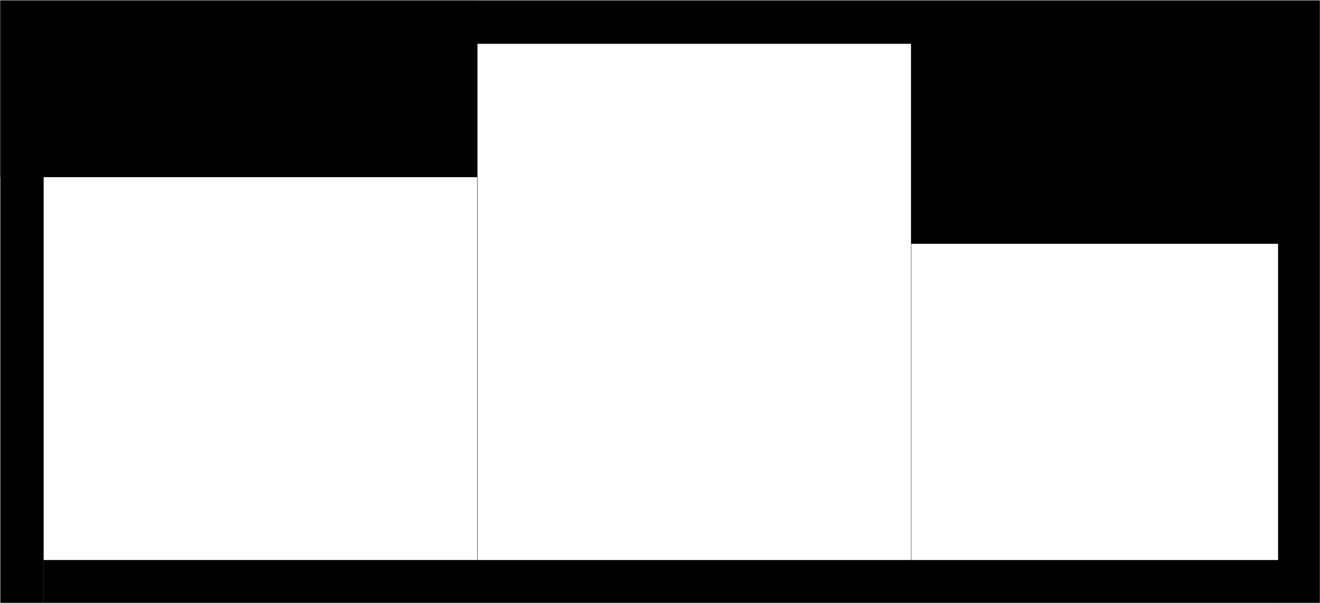
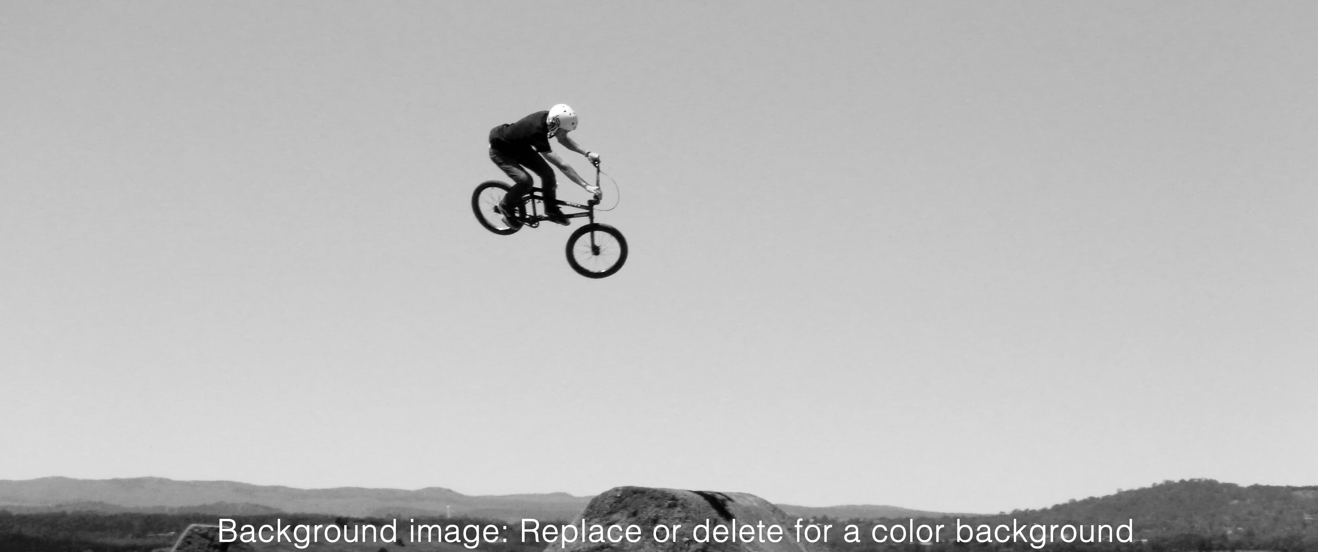


1
2
3

Slide 2
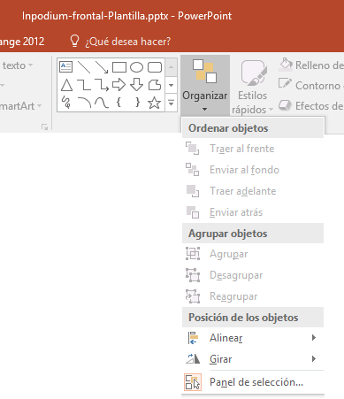
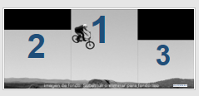
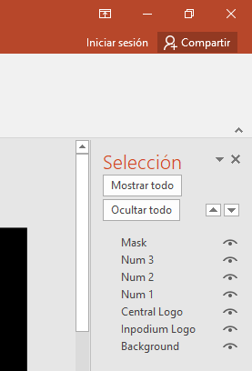
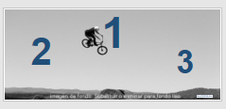
CUSTOMIZATION INSTRUCTIONS 1 For designing an exclusive front for INPodium.
The first slide is an example of a custom front for INPodium and you can use it as a template to make your own designs.
Duplicate slide 1 to make various alternative designs.
Activate the "selection panel" to see the images that make up that template:
Click Start / Organize / Selection Panel.
The "Selection" panel will appear at the right side of the screen.
The "Selection" panel displays a list of images contained in each slide and its order.
Images at the top of the list are superimposed to the images below.
Preview mode: The "Mask" image is activated and located at the top. The template is displayed exactly as it will be printed.
Design mode: The "Mask" image is disabled or moved to the end of the list
Rearranging images tool.
Activate or deactivate image tool

Slide 3
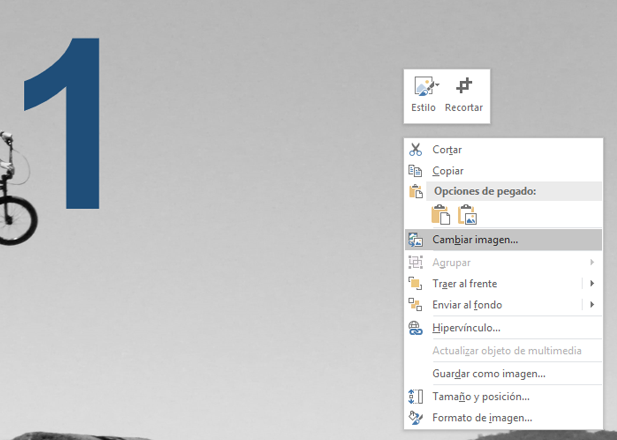
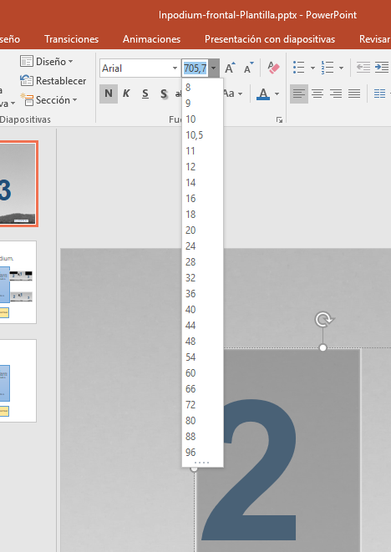
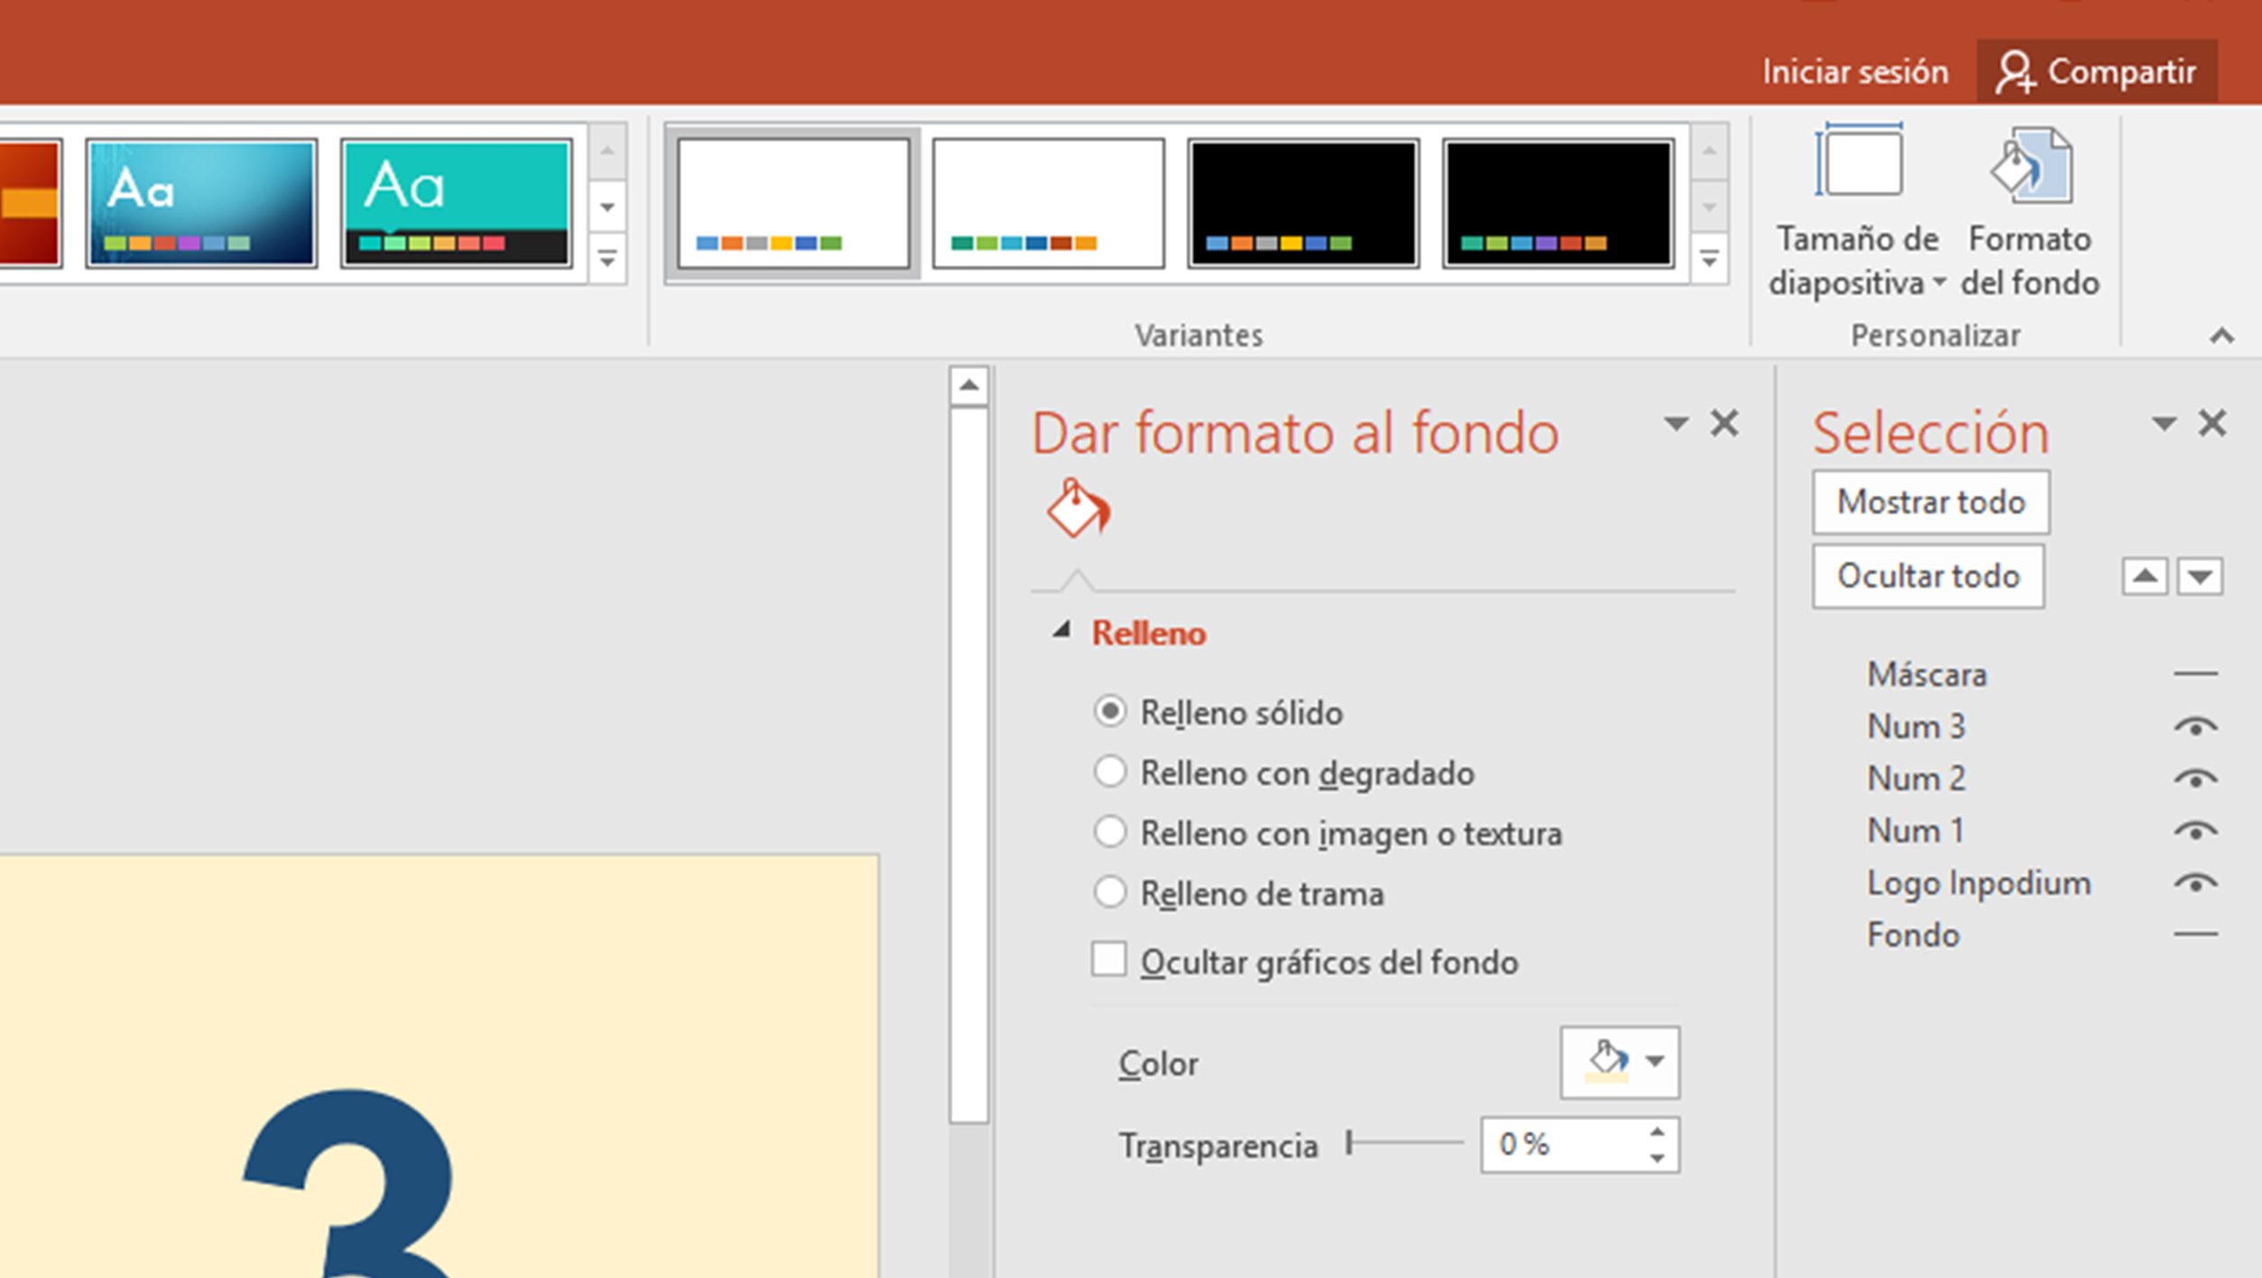
CUSTOMIZATION INSTRUCTIONS 2
Adjusting the size of texts and numbers:
The size of the slide is the actual size of the Inpodium front, much larger than the normal working size in PowerPoint, so the predefined font sizes are very small.
To enter larger sizes than the predefined, type the desired font size instead of selecting it from the drop-down list.
Background:
As background you can use an image like the one in the example or the PowePoint plain color or dye.
Use an image:
Select the current background image
Right-click on it
Select "Change Image“ and select a new image from your computer.
Adjust the size and position if necessary.
Use smooth or woven background:
Delete or clear the current background.
Go to Design menu, choose Background Format, and design your background with the PP tools.
Insert text and images:
With the PowerPoint design tools you can insert as many images and texts as you need, changing their position, size, font or color according to your convenience.

Slide 4
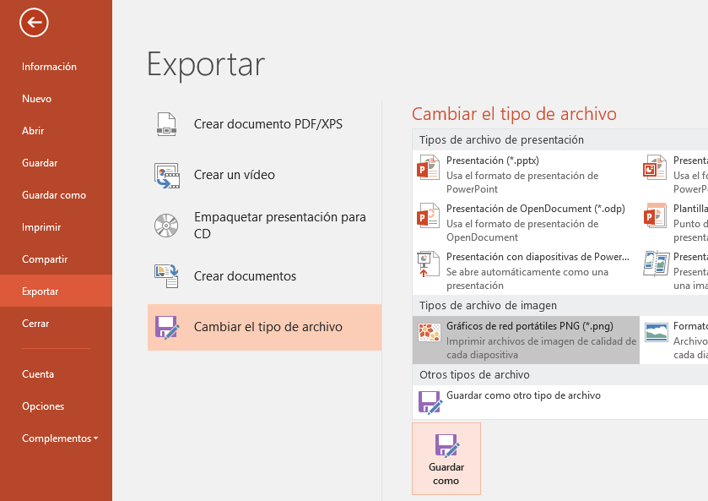
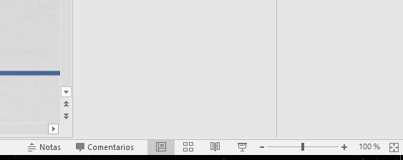
CUSTOMIZATION INSTRUCTIONS 3
Check the print quality before sending:
This template allows you to visually check the final quality with which the personalized fronts will be printed, so you only have to zoom in at the bottom right and check the quality of the images and logos.
If the pixel quality of the images, letters and logos does not consider it acceptable to print their fronts, proceed as follows:
Replace images with higher quality ones.
Replace the logos with larger ones or use a vector format, which allows them to be enlarged without limits or quality losses.
To reset the job view, use the "Adjust slide to the current screen" button, placed at the right of the zoom slide.
Export the final file to send:
Once the front design is finished, you should export it to a png image file which will be used for printing.
Go to File / Export / Change File Type / Portable Network Graphics PNG / Save As
Put a name for the png file and save it to your PC.
Sending the file to print:
Send an email with the file to designs@intrainers.com please remeber to indicate the Order Number.

